Slide 1
Battle of Neighborhoods
New York City

Slide 2
Introduction
This project analyzes neighborhoods of New York City in respects of all major venues of neighborhoods in any borough and rental analysis. New York City is very diverse and multicultural city. NYC has been distributed over a land of 302.6 square miles as per wiki. This city consists of 5 boroughs as: Brooklyn Manhattan Queens Staten Island Bronx

Slide 3
New York City is also the most densely populated major city in the United States. Located at the southern tip of the state of New York, the city is the center of the New York metropolitan area, the largest metropolitan area in the world by urban landmass and one of the world's most populous megacities, with an estimated 20,320,876 people in its 2017 Metropolitan Statistical Area and 23,876,155 residents in its Combined Statistical Area. A global power city, New York City has been described as the cultural, financial, and media capital of the world, and exerts a significant impact upon commerce, entertainment, research, technology, education, politics, tourism, art, fashion, and sports. The city's fast pace has inspired the term New York minute. Home to the headquarters of the United Nations, New York is an important center for international diplomacy.

Slide 4
This project surely proves very helpful for any visitor or employee or student who comes to this great city with intention to live here.

Slide 5
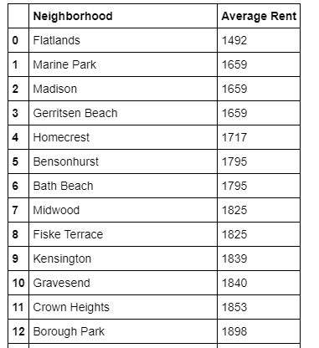
Rental Average of NYC neighborhoods
Some Neighborhoods in Brooklyn:

Slide 6
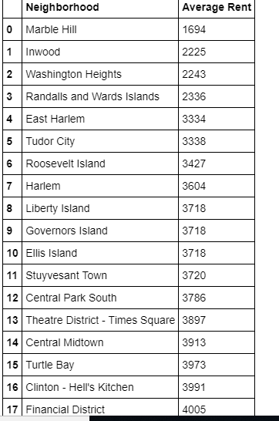
Neighborhoods in Manhattan:

Slide 7
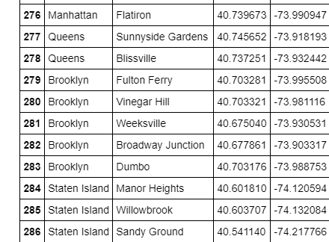
Longitudes and Latitudes of NYC Neighborhoods

Slide 8
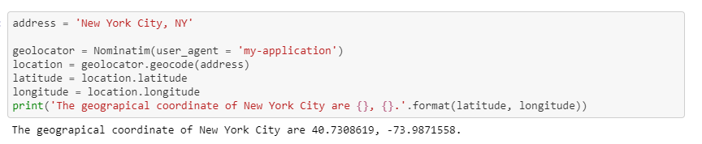
Geographical coordinates of NYC

Slide 9
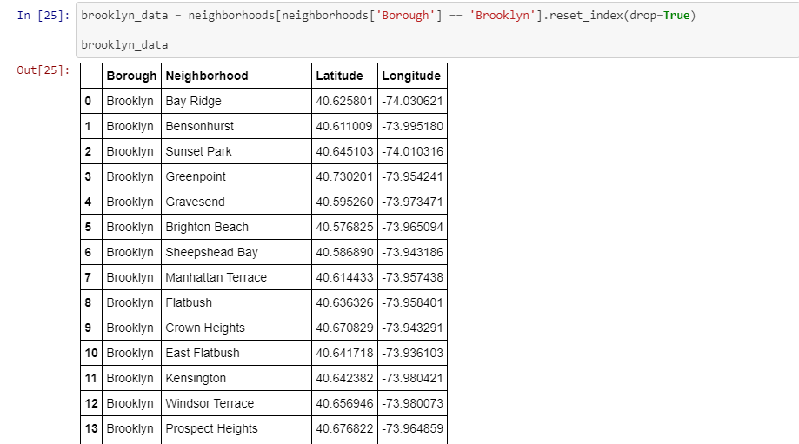
Longitudes and Latitudes of Neighborhoods in Brooklyn

Slide 10
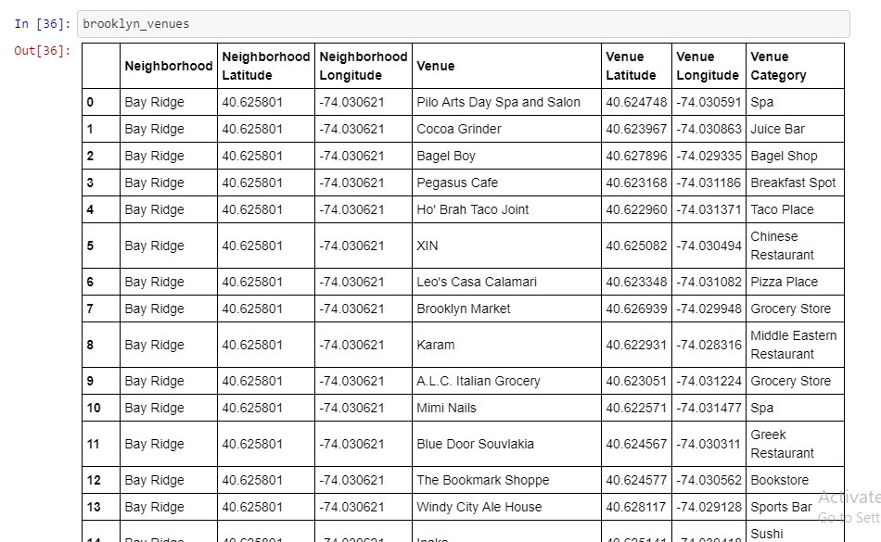
Venues in Brooklyn Using Foursquare API

Slide 11
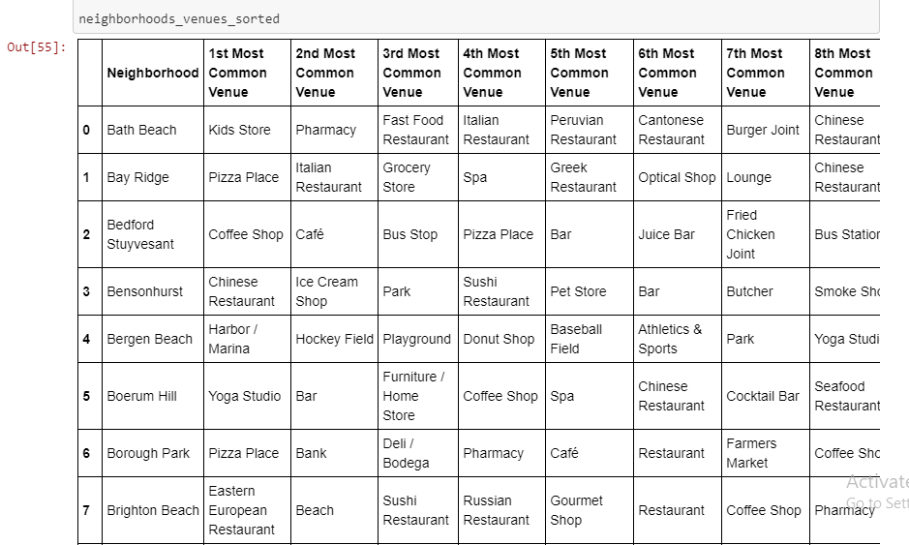
Filtered Most Common venues in Brooklyn as per Foursquare data

Slide 12
Conclusion
Now it would be easy for anyone who is moving to New York City. As we have rental data and all venues too.
As we are discussing this problem. Anyone can get rental data and neighborhoods details from the above mentioned codes and resultantly finds himself best match of Neighborhood as per your requirement for cafes, coffee shops, restaurants etc.
This code is for Brooklyn borough. We can use the extension of this code for other boroughs too.

